Slide 1
Module 6 – Probability Distributions

Slide 2
Motivation
Probability, statistics, and data analytics in general are used to describe real-life phenomena, which follow different distributions.
e.g. In healthcare, the outcome of patients cured by a drug can follow a binomial distribution.
In insurance industry, the number of cars involved in an accident each month can follow a Poisson distribution.
In manufacturing, the lifetime of machines in a sample can follow a normal distribution.
For each random variable, we can calculate the mean (expected value), variance, and standard deviation.

Slide 3
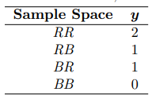
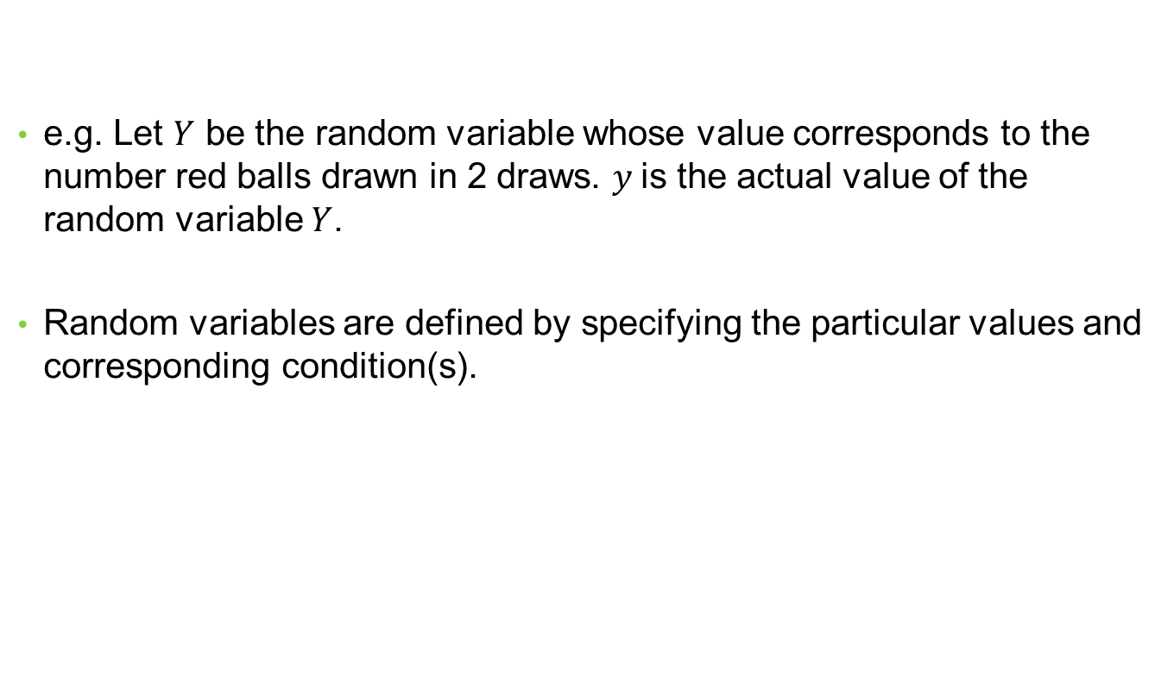
Random Variable
e.g. Let $Y$ be the random variable whose value corresponds to the number red balls drawn in 2 draws. $y$is the actual value of the random variable $Y$.
Random variables are defined by specifying the particular values and corresponding condition(s).

Slide 4
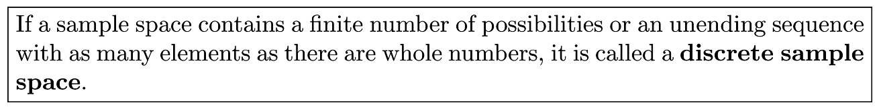

Random Variable
A Bernoulli random variable takes on a value of 0 or 1.
e.g. $X=\left\{\begin{aligned}1, if a customer is male \\ 0, if female\end{aligned}\right.$
e.g. $X=\left\{\begin{aligned}1, if a user clicks on an ad \\ 0, otherwise\end{aligned}\right.$

Slide 5
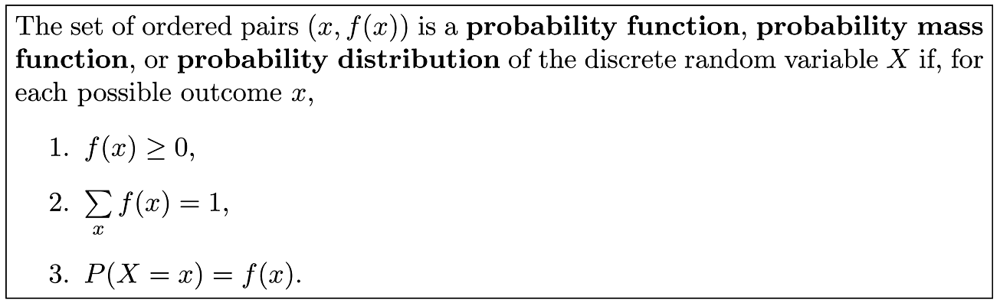

Discrete Probability Distributions
Property 1: All probabilities must be greater than or equal 0.
Property 2: Sum of all probabilities of values of a r.v. is 1.
Property 3: The notation specifying the probability of the r.v. $X$ taking the value $x$.

Slide 6
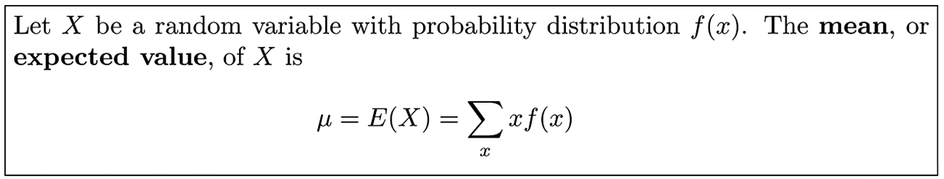

Mean of a Random Variable
e.g. Let $X$be the number of heads when a coin is tossed twice.
$S = \{HH, HT, TH, TT\}$, $P\left(X = 0\right)=P\left(X =2\right)=\frac{1}{4}$ , $P\left(X = 1\right)= \frac{1}{2}$
$μ = E\left(X\right)= \left(0\right)\frac{1}{4} + \left(1\right)\frac{1}{2} + \left(2\right)\frac{1}{4} = 1$

Slide 7
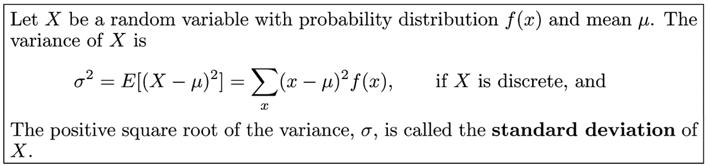

Variance of a Random Variable
$σ^{2}=E\left[{\left(X−μ\right)}^{2}\right]=\frac{\sum{{\left(x−μ\right)}^{2}}}{N}$ is the population variance of X.
$σ$ is the population standard deviation of X.
$s^{2}=\frac{\sum{{\left(x−\overline{x}\right)}^{2}}}{n−1}$ is the sample variance, which is divided by $n−1$ to correct for bias.

Slide 8


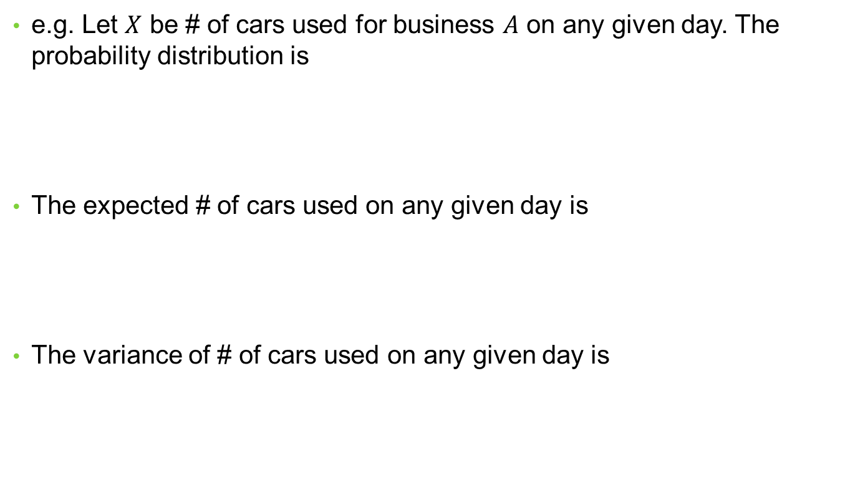
Variance of a Random Variable
e.g. Let $X$ be # of cars used for business $A$ on any given day. The probability distribution is
The expected # of cars used on any given day is
The variance of # of cars used on any given day is

Slide 9
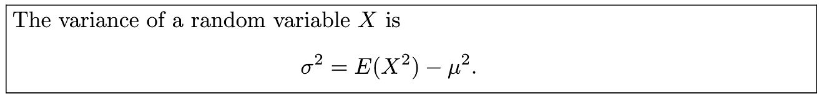
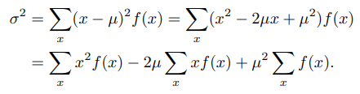


Variance of a Random Variable
Proof:
Using the following properties
We have

Slide 10

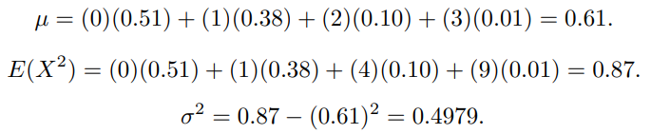

Variance of a Random Variable
e.g. Let $X$ represent the # of defects when 3 items are sampled. The probability distribution of $X$ is
To find the variance of $X$, we need to find $E(X)$ and $E(X^{2})$

Slide 11
Binomial Distribution
Used in situations where the outcome is binary (e.g. Cured by a drug or not, getting a disease or not, successful or failure in an event, etc).
The Bernoulli Process:
1. The experiment consists of repeated trials.
2. Each trial results in an outcome that may be classified as a success or a failure.
3. The probability of success, denoted by $p$, is constant for all trials.
4. The repeated trials are independent

Slide 12
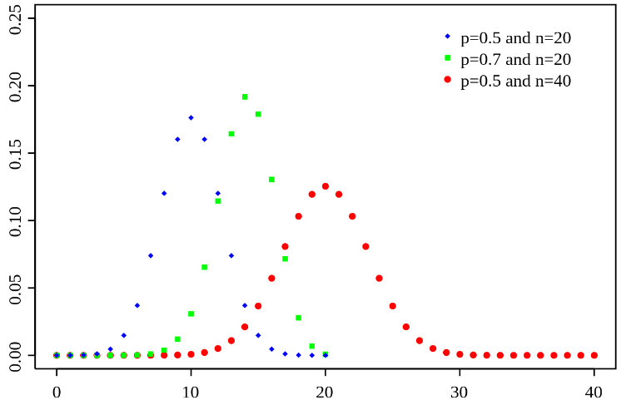
Binomial Distribution

Slide 13
Binomial Distribution
The number $X$ of successes in $n$ Bernoulli trials is called a binomial random variable.
The probability distribution of $X$ (probabilities of success and failure) is called the binomial distribution.
Specifically, probability of success is $p$, while probability of failure is $q = 1− p$.
Probability of getting a particular combination of successes/failures is $\left({n \atop x}\right)p^{x}q^{n−x}$ where $\left({n \atop x}\right)$ is the combination of having $x$ successes in $n$ trials.

Slide 14
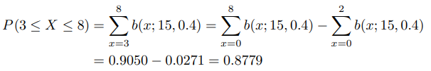
Binomial Distribution
e.g. The probability that a component will pass a test is $\frac{3}{4}$.
The probability that exactly 2 of the next 4 components passing the test is$\left({n \atop x}\right)p^{x}q^{n−x}=\left({4 \atop 2}\right)p^{2}q^{4−2}=\frac{4!}{2!2!}{\left(\frac{3}{4}\right)}^{2}{\left(\frac{1}{4}\right)}^{2}=\frac{27}{128}$
e.g. The probability that a patient recovers from a disease is 0.4. If 15 people are get this disease.
The probability that from 3 to 8 survive is

Slide 15
Applications of Binomial Distribution
Used when the outcome of an event is binary. e.g.
Finding probability of certain number or range of defects (manufacturing).
Outcome of a clinical experiment (healthcare).
Winning the lottery or a bet (gaming).
Winning a game or not (sports), a flight on time or not (transportation)…

Slide 16

Poisson Distribution and the Poisson Process
Poisson distribution is used to model the number of events that happen over a period of time.
Poisson process is memoryless. i.e. The number of events in the past does not affect the probability of getting an event in the current period.
Let $X$ be the number of events in a period of time. The Poisson probability distribution of the random variable $X$ is
$λ$ is the average number of events per unit time $t$ and $e = 2.71828$…
The mean and variance of Poisson distribution are both $λt$.

Slide 17
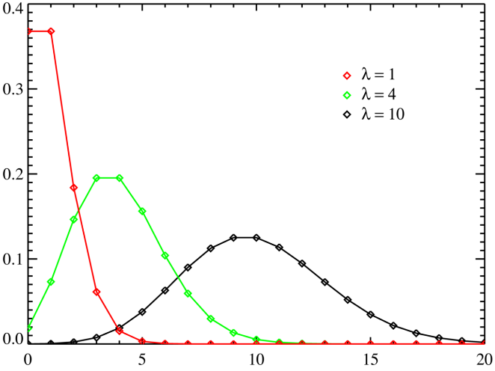
Poisson Distribution and the Poisson Process

Slide 18


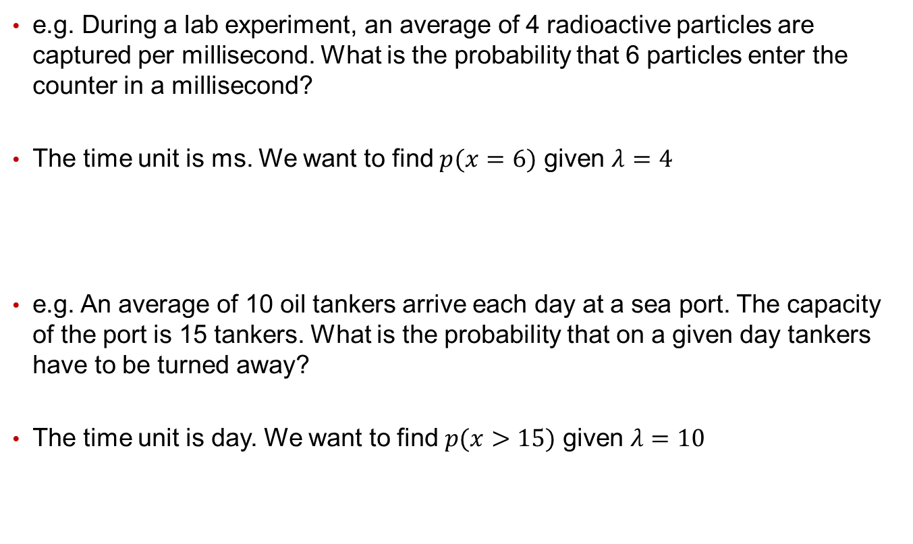
Poisson Distribution and the Poisson Process
e.g. During a lab experiment, an average of 4 radioactive particles are captured per millisecond. What is the probability that 6 particles enter the counter in a millisecond?
The time unit is ms. We want to find $p(x=6)$ given $λ=4$
e.g. An average of 10 oil tankers arrive each day at a sea port. The capacity of the port is 15 tankers. What is the probability that on a given day tankers have to be turned away?
The time unit is day. We want to find $p(x>15)$ given $λ=10$

Slide 19
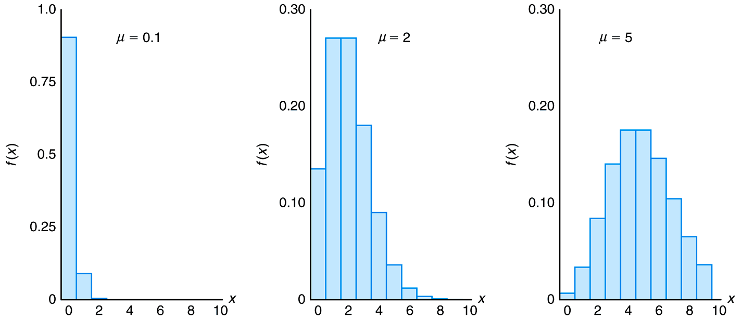
Poisson Distribution and the Poisson Process
The shape of the Poisson distribution changes with the parameter $λ$.
Most Poisson distributions are right-skewed (tail on the right).
e.g. In insurance industry, majority get into 0 or 1 accidents per year.

Slide 20
Application of Poisson Distribution
Find number of calls received per hour by a call center, which can be used for scheduling purposes.
Find number of patients coming to emergency per hour, which again can be used for scheduling medical staff.
Find number of car accidents someone gets into per year, which can be used to model insurance premiums and amounts insured.
Find number of games postponed due to rain during a baseball season.
…and more

Slide 21
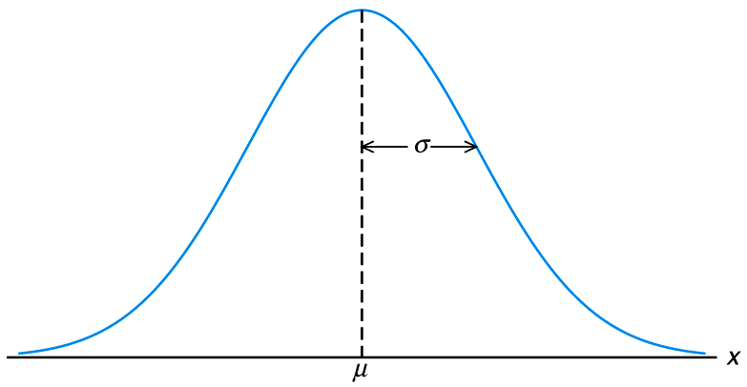
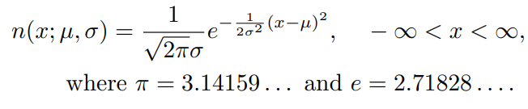

Normal Distribution
Assumes a symmetric (bell-curve) distribution of possible values of random variable $X$.

Slide 22
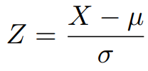
Standardized Normal Distribution
Normal distributions for different variables can be difficult to compare against each other.
e.g. The distribution of age and income would have means that are much different.
A convenient way is to standardize the distributions to mean 0 and variance 1 -> The standard normal distribution.
All values x in the original distribution can be converted into a standardized measure, the Z-score:

Slide 23

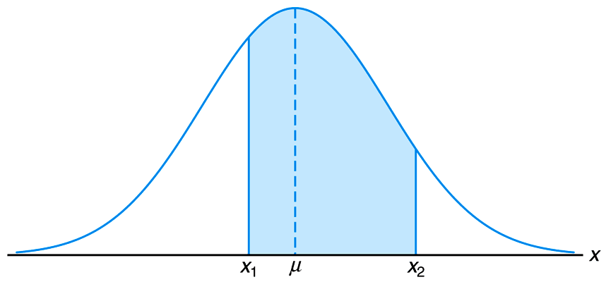

Areas Under the Normal Curve
Probability of a range of values of random variable $X$ in a continuous distribution must be obtained by integration under the pdf.

Slide 24
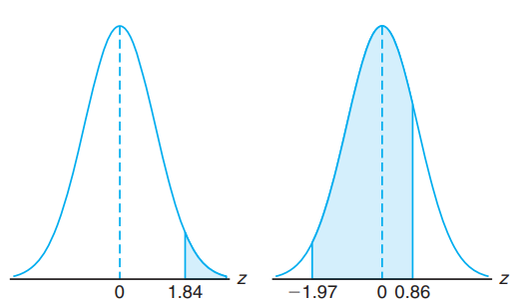

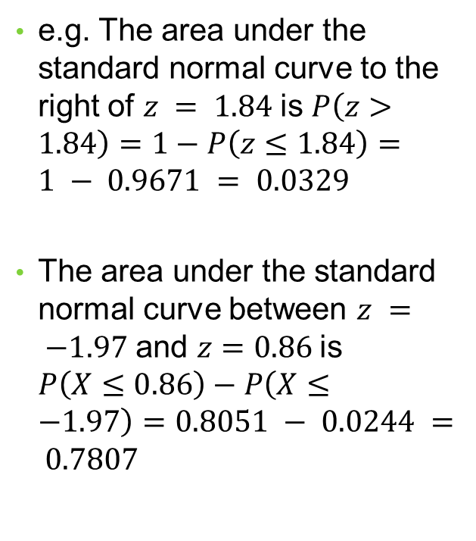
Areas Under the Normal Curve
If we convert the values of random variable X into Z-scores, it’s much easier to calculate the area under the normal curve using pre-determined numbers that correspond to each $P(X≤z)$.
e.g. The area under the standard normal curve to the right of $z = 1.84$is $P\left(z>1.84\right)=1−P\left(z≤1.84\right)=1 − 0.9671 = 0.0329$
The area under the standard normal curve between $z = −1.97$ and $z=0.86$is $P\left(X≤0.86\right)−P\left(X≤−1.97\right)=0.8051 − 0.0244 = 0.7807$

Slide 25
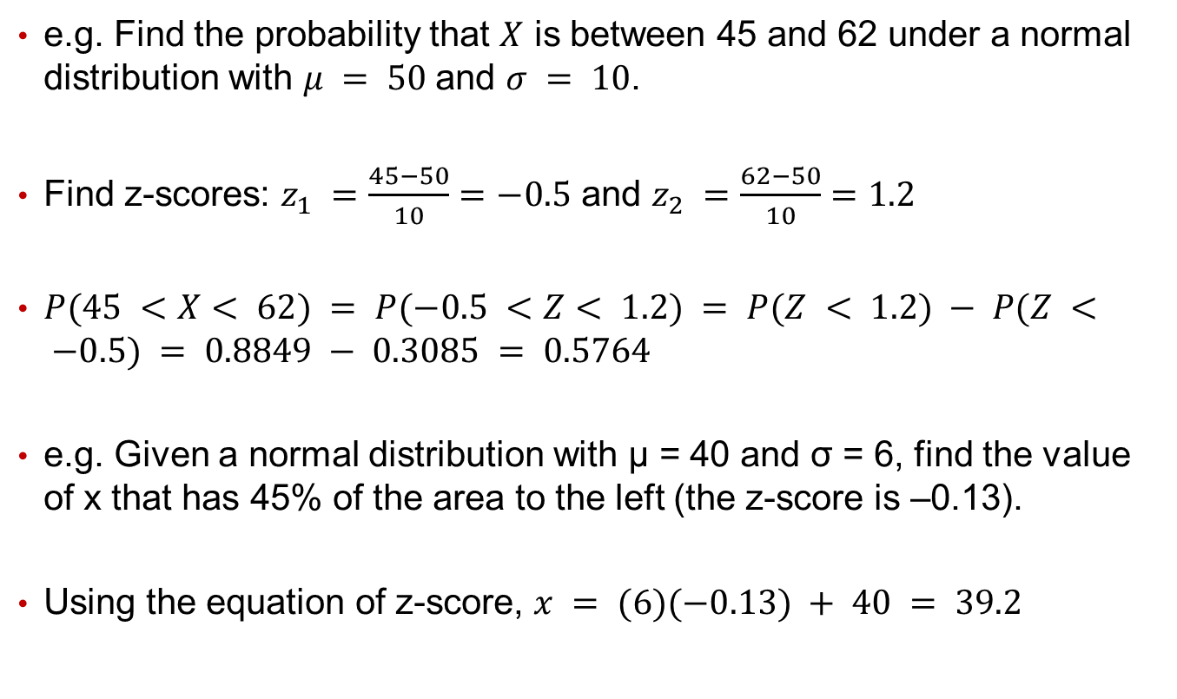
Areas Under the Normal Curve
e.g. Find the probability that $X$ is between 45 and 62 under a normal distribution with $μ = 50$and $σ = 10$.
Find z-scores: $z_{1} =\frac{45−50}{10}=−0.5$ and $z_{2} =\frac{62−50}{10}=1.2$
$P(45 <X< 62) = P(−0.5 <Z< 1.2) = P(Z < 1.2) − P(Z < −0.5) = 0.8849 − 0.3085 = 0.5764$
e.g. Given a normal distribution with μ = 40 and σ = 6, find the value of x that has 45% of the area to the left (the z-score is –0.13).
Using the equation of z-score, $x = (6)(−0.13) + 40 = 39.2$

Slide 26
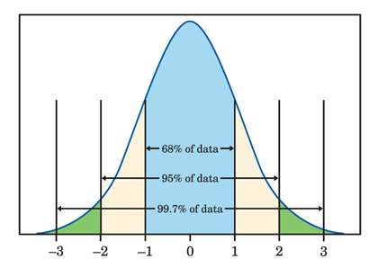
The 68–95–99.7% Rule
In any normal distribution, approximately:
68% of the observations fall within one standard deviation of the mean.
95% of the observations fall within two standard deviations of the mean.
99.7% of the observations fall within three standard deviations of the mean.
Total area under the curve is 100%.

Slide 27
Applications of the Normal Distribution
Normal distribution may be the probability distribution with the most applications.
It’s also used as the assumption of many statistical methods such as linear regression.
It can be applied in virtually all industries to model life of devices and machines, height and weight of people and animals, economic measures, production, stock returns, educational scores, and more.

